Slide 1
Business insights from Telco Customer Tickets

Slide 2
Content : 1. Synopsis 2. Methodology & Tools Used 3. Project Flow 4. Executive Summary 5. Objective & Business Problem – Quantify Statement 6. Excel Analysis to build up stories and proposing logical EER diagram 7. My SQL base analysis – Schema creation , Tables creation, Inserting of data & designing of EER diagram 8. My SQL & Tableau live demonstration [During TA session] along with Queries samples. 9. Cross intersecting Excel – My SQL queries & Tableau for understanding Business insight and deriving solutions/suggestion 10. Dashboards & Charts to Visualize the data and give insights. 11. Executive Summary of Business Problem and Suggestion/Solution proposed. 12. Recommendation and lesson’s learnt from the project

Slide 3
_{SYNOPSIS:}
Project is based on telco customer complaint public dataset of complaints raised [i.e _{SR Raised].}
This project is completely based on customer feedback of telco service and giving suggestion to telco provider to become more of customer centric apart from giving service's and leading them to higher market potential w.r.t competitor. This dataset corresponds to SR ID, SR Type, Technology Type, SR raised Date, Resolution date, SLA Time, SR Source Type, Customer Account type, Customer details like Name, Address, Customer Type, Area, Geo Lat & Long etc. Using this data, we intend to analyze SR trends over a given Time period, Average SR raised & time spends for resolutions, delivery performance patterns, Source of SR along with Customer type and Geo location and impact on Business and customer.
The goal behind is to ‘put it all together’ by developing a Coherent, Concise, and Realistic analysis in the form of a report and give business insights from customer tickets and further scope for improvement in that domain with strong suggestion and recommendations.
_{GOAL : Prime} goal is to analyze Service Request [SR’s] data and come up with actionable insights based on the data, to improve service quality, _{customer satisfaction} which overall enhance business

Slide 4
METHODOLOGY AND TOOLS USED
Service Request data is available on https://data.gov.in – TRIA web site in form of CSV files containing various customer’s raised complaints along with necessity information, Complaint type and technology, Customer class (Gold, silver, corporate etc.), SLA and other dimensions
Work Task | Tools Used
Cleanup the CSV data (Remove unwanted & Blank fields, sanitize/format some of them such as Zip codes, Address, Names, Lat-Long) | MS Excel
 | Open Refine
Design EER diagrams and various analysis dimensions (such as Customer & source Type, Technology, SLA and SR Status along with Geo Lat-Long) | My SQL Workbench
Create database and Tables based on the ER diagram | My SQL Workbench
Create Schema and Import the Telco Data inside the tables via Insert Command | My SQL Workbench & MS Excel
Commanding Queries and Views to gather insights from the Telco data, Analyze the data and conclude for Business Problems and Way forward | My SQL Workbench
Prepare Dashboards and Charts to Visualize the data and give and share insights | Tableau
 | MS Office

Slide 5
Finalizing the Data set & accumulating the Data from TRIA Web site
Cleaning up of data with help of Open refine & MS Excel
Excel Analytics to under stand the Data Set
In Search of Data for Project
Creation of Tables & Database along with designing of EER Diagram
Proposing required Tables along with 3NF creation and Logical EER model
Final Milestone to demonstrate & project submission
Schema creation and Importing dataset
Building Up multiple Queries & Views
Prepare Dashboards and Charts to Visualize the data and give insights along with Suggestions
Performing Analyzing & deriving Insight of Dataset and Building Up Business Problems & Solutions / Suggestions
Data analysis and Visualization using Excel & Tableau
Team Presentation in TA session along with Business Insights
PROJECT FLOW

Slide 6
EXECUTIVE SUMMARY :: OBSERVATIONS
Based on Data Analysis done for Telco Service Requests:
46% Issues reported via Source Type : Toll Free Telco Call Center Channel. 8% Issues are reported via Source Type : Social media → Major chunk is via Twitter [~50%]
~48% cases under the SR category : Resolved, are been resolved <=5 days [SLA]
No. of Complaints raised by the customer are into declining trend over the time and ~>=50% SR’s raised case are still under Open/On-Hold category i.e Un-resolved
~61% of Customer SR’s are for Voice issues & 35% for Data issues and ~4% for other issues
Major chunk in Voice is 3G Voice [54% w.r.t Total Voice Complaints] and in Data is 4G Data [91% w.r.t Total Data Complaints]
87% SR’s raised are from Customer type : Gold and Type : Platinum – 13%
73% SR’s are from Customer class : Induvial, followed by ~26% from Customer class : Corporate/Medium/Micro & Small enterprise

Slide 7
OBJECTIVE : UNDERSTANDING THE BUSINESS PROBLEM :
Deep dive on SR's and suggesting reduction opportunity along with insights, so that company has opportunity to have higher customer satisfaction index which helps in leading them for higher market potential [Customer and revenue wise] w.r.t other competitor.
No. of SR’s vs Technologies vs Issue Type.
No. of SR’s vs Source Type and Sub-Category
No. of SR’s vs Customer Type and class
No. of SR’s vs Locations vs SR’s status
No. of SR’s vs SR’s status vs SLA days

Slide 8
My SQL based Analysis

Slide 9
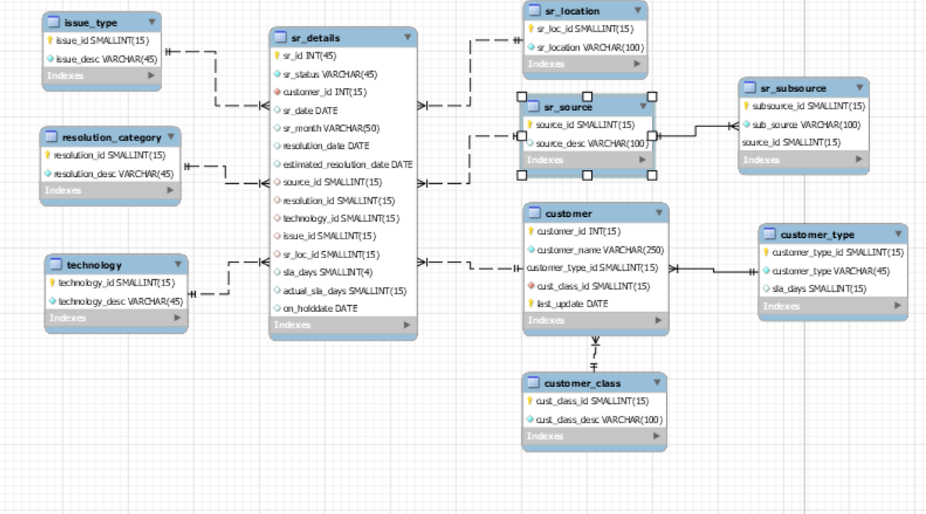
Logical EER Diagram

Slide 10
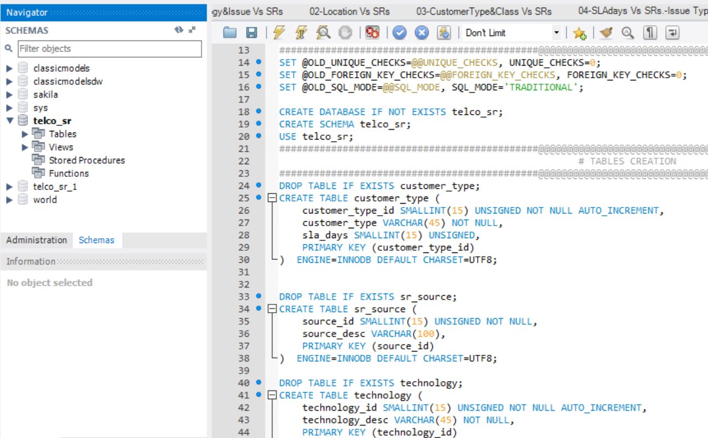
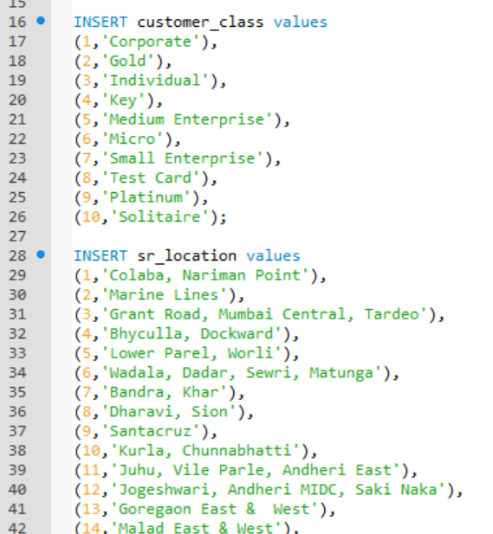
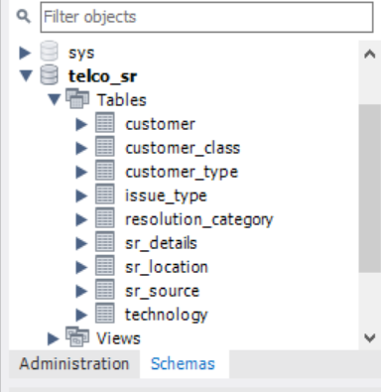
How Schema & Tables Created and Data was Inserted
Schema creation
Insert the data base

Slide 11
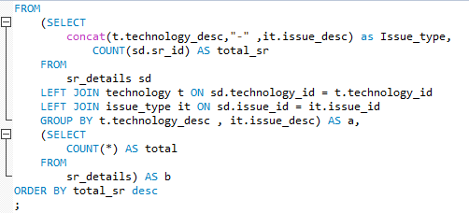
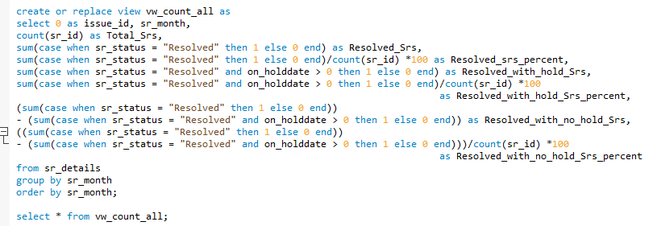
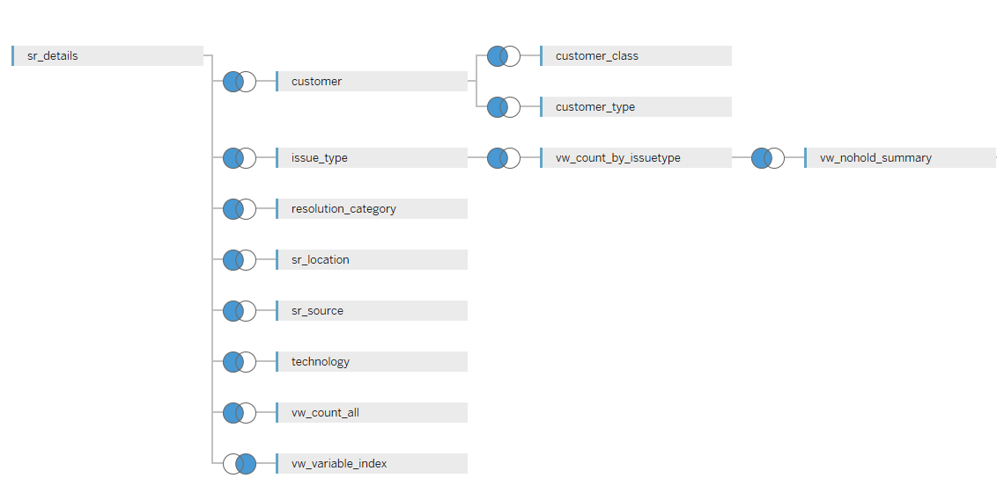
Use of Joints and View for Queries and linking data with Tableau
Use of Joints & Views
1
2
3

Slide 12
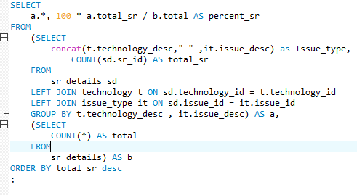
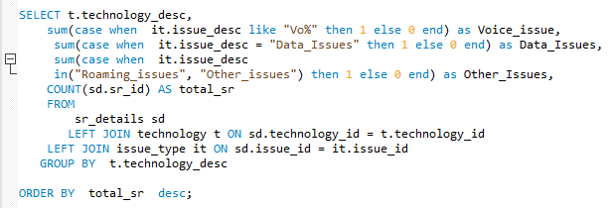
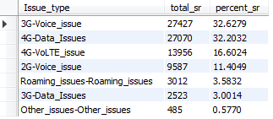
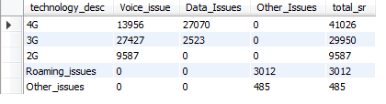
Example 1 - SQL Queries along with Output
Query : Technology - Issue type bifurcation w.r.t total SR’s
Query : Matrix between Technology and Issue type
Output
Output

Slide 13
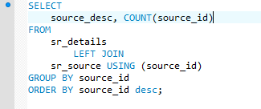
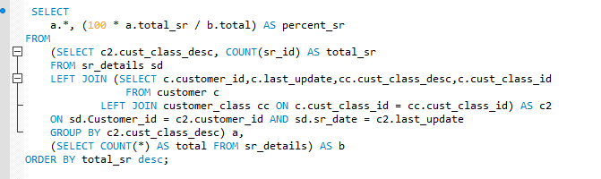
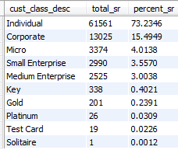
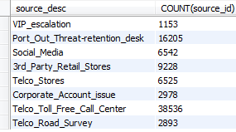
Example 2 - SQL Queries along with Output
Query : Source Type vs No. of SR
Query : Customer Class vs No. of SR’s
Output
Output

Slide 14
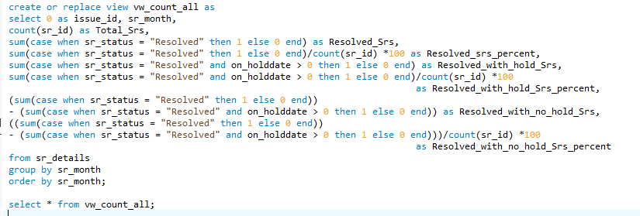
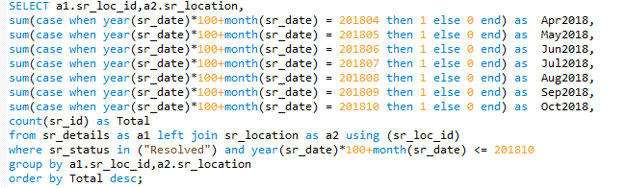
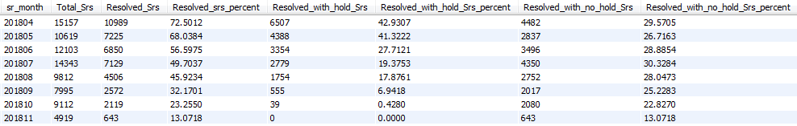
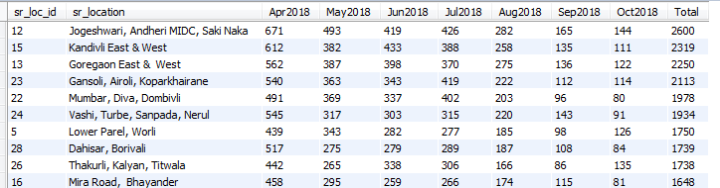
Example 3 - SQL Queries along with Output
Query : Month on Month SR’s vs SR Status distribution
Query : Month on Month SR’s vs SR’s Location
Output
Output

Slide 15
Excel Analysis to understand SQL Output data and build up stories

Slide 16
1. Excel Analytics and Data Insight
Location Name
Location ID
Highs : - No. of SR’s Month on Month is into decreasing trend.
- 50% SR’s raised by customer has status is Resolved
Lows : 46% SR’s are attended but still not resolved [On-Hold], rest 4% still Open
Highs : Location ID 1 to 4 :: Lowest SR’s :: High Customer Satisfaction Index
Lows : Location ID 12, 13 & 15 :: Highest SR’s :: Low Customer Satisfaction Index

Slide 17
2. Excel Analytics and Data Insight
Lows [Technology & Issues] : 3G – Voice [33%] & 4G – Voice [17%] & 4G – Data [32%] is Major Chuck for Voice & Data related issues respectively.
Highs : - 2G Voice has very less contribution, which say that majority of customers are using smart phone.
- Roaming issue is very rarely reported, hence there is no intra-inter roaming issues.

Slide 18
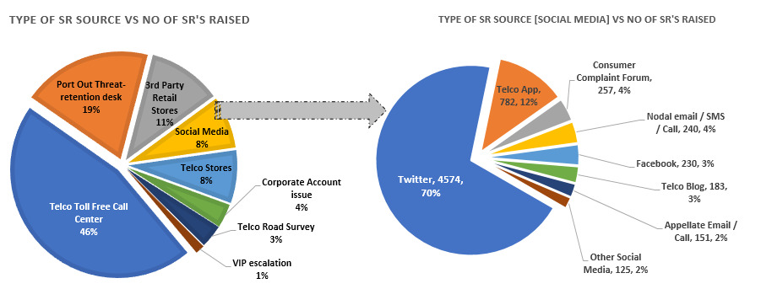
3. Excel Analytics and Data Insight
Highs : - ~1% SR’s are obtain via Source Mode : VIP escalation
Lows : - 19% SR’s are reported :: Source :: Port Out Threat desk, need special attention to avoid churn out to competitor & loss of revenue
- 8% SR’s are reported :: Source :: Social Media, Major chunk from Twitter [70%]

Slide 19
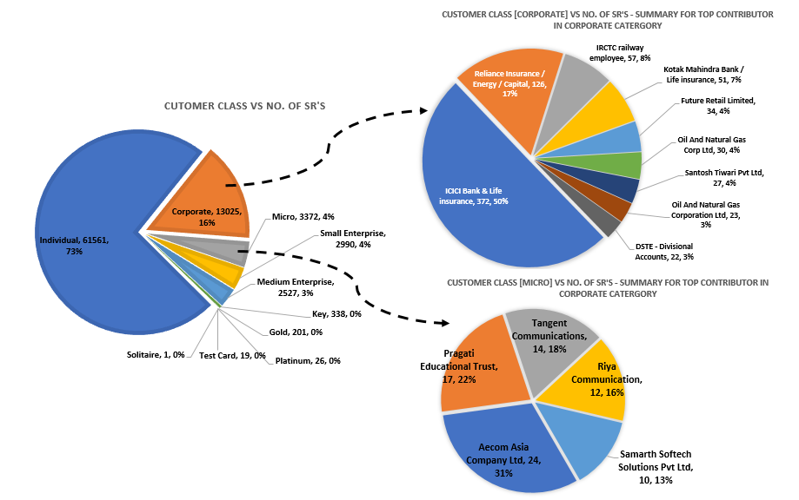
4. Excel Analytics and Data Insight
Highs : - <1% SR’s are raised by Solitaire / Platinum customer’s.
Lows : - 73% SR’s are raised by individual's
- 27% SR’s are raised by Corporate’s / Small Enterprise or sectors, need special attention to avoid churn out to competitor.

Slide 20
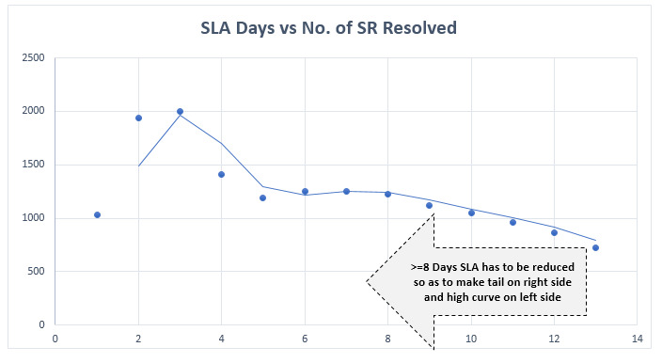
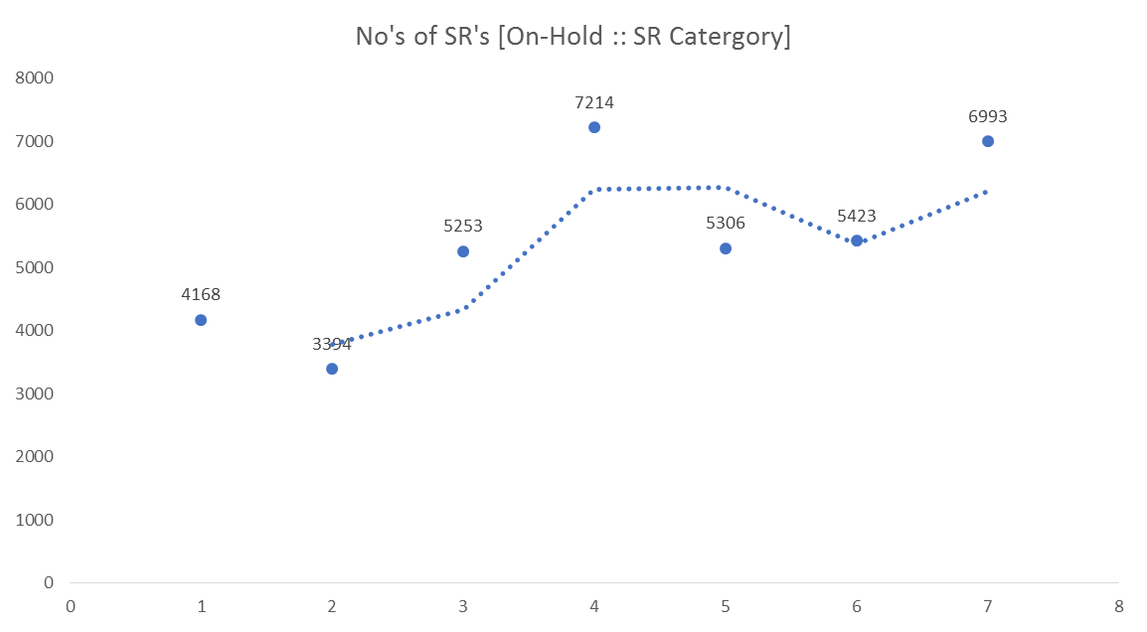
5. Excel Analytics and Data Insight
No's of SR's [On-Hold :: SR Category]
No. of SR’s :: On-Hold
No. of SR’s :: Resolved
SLA Days
Month No
Highs : - 48% SR’s under Resolved category have <=5 days SLA days. - 2 to 4 Days is the average SLA days.
Lows : - Minimize SLA days, should target >=8 days SLA days [39%]. - Month on Month - Increasing Trend - No. of SR’s under SR Status :: On-Hold.

Slide 21
Data analysis, Visualization and story making using Tableau
Note : In these section we tried to compare & make Charts/Story as similar to that of SQL output and Excel charts

Slide 22
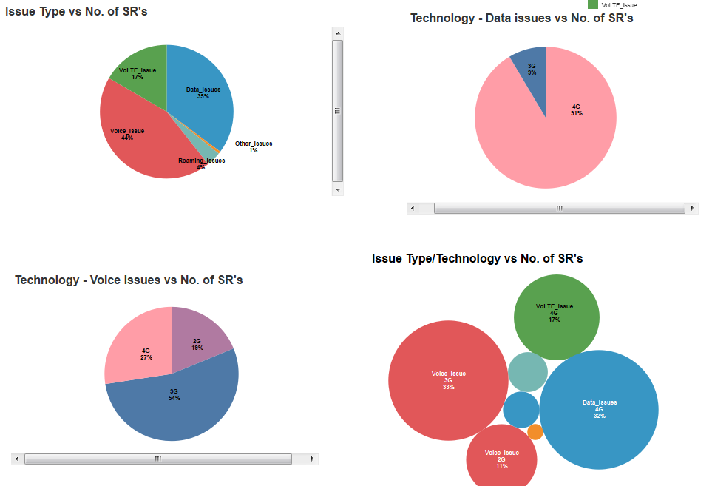
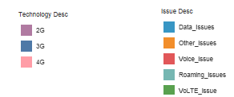
1. Business Problem : To acknowledge which service’s across technology is doing well & the most frequent issue type faced by the customer which needs attention.
Observation : Highs : - 2G Voice has very less contribution, which say that majority of customers are using smart phone.
- Roaming issue is very rarely reported, hence there is no intra-inter roaming issues.
Lows : 3G – Voice [33%] & 4G – Voice [17%] & 4G – Data [32%] is Major Chuck for Voice & Data related issues respectively.

Slide 23
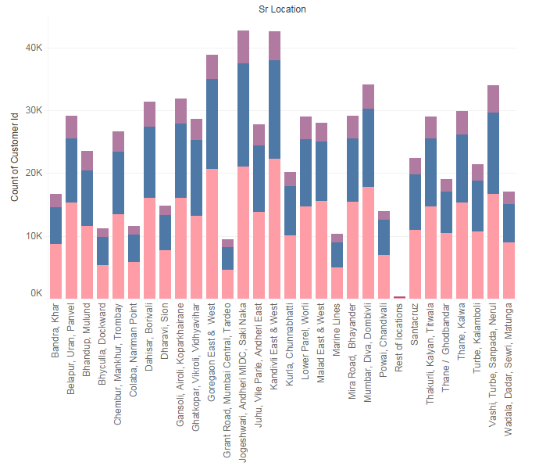

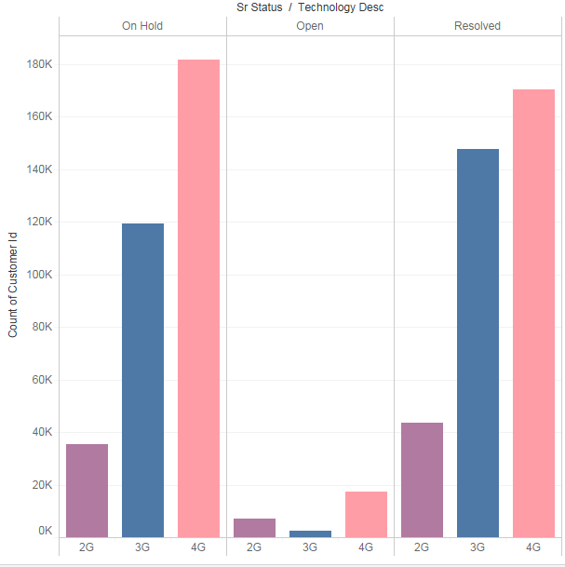

1. Business Problem : To acknowledge which service’s across technology is doing well & the most frequent issue type faced by the customer which needs attention. [Continue…………………..]
Solution / Suggestion :
- More Focus on resolving 3G Voice issues & 4G Data Issues.
- Insist to push customer’s to use VoLTE service which has higher performance metric.
- Identified areas were Coverage & Capacity Augmentation is required for 3G Voice & 4G Data issues [No coverage / Congestion/Buffering/Low speed etc]
- No. of SR’s raised for 4G Data are addressed but still un-resolved [i.e On-Hold], special focus has to be given for faster closer.

Slide 24
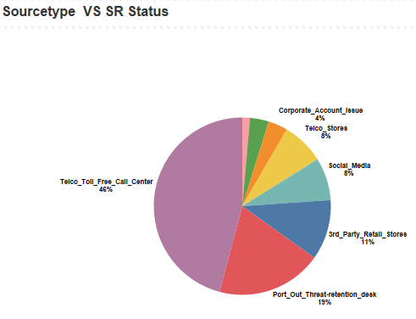
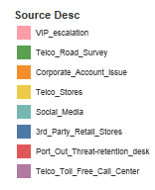
2. Business Problem : To acknowledge which is the most used source for reporting issues & the most frequent used sub-source type by the customer which needs attention and lower SLA.
Highs : - ~1% SR’s are obtain via Source Mode : VIP escalation
- Social Media has the lowest SLA days w.r.t other source type.
Lows : - 19% SR’s are reported :: Source :: Port Out Threat desk, need special attention to avoid churn out to competitor & loss of revenue
- 8% SR’s are reported :: Source :: Social Media, Major chunk from Twitter [70%]
- Corporate Account has the highest SLA days w.r.t other source type.

Slide 25
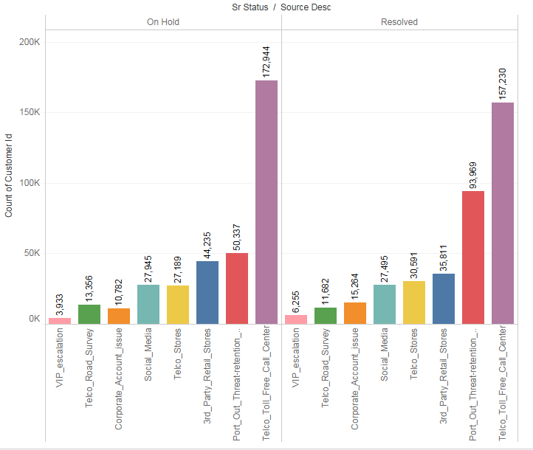
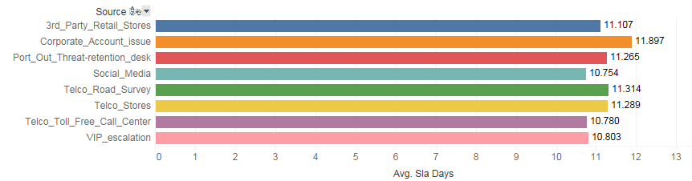
2. Business Problem : To acknowledge which is the most used source for reporting issues & the most frequent used sub-source type by the customer which needs attention and lower SLA. [Continue…………………..]
SR Source vs SR status
Solution / Suggestion :
- More Focus on resolving Telco Call center cases.
- Guide and train customer care faculty to understand customer’s VOC and try to resolve the issues at that moment is remotely possible, these will help to reduce in-flow of SR’s.
Avg. SLA has to minimize [Currently Avg. SLA >=10 Days].
Focus required for Corporate Account [“high SLA days”]
Special benchmarks to be made to reduce SLA days for Corporate Accounts , VIP escalations and Social media cases as they directly links companies performance and reputation.
Ideal value
SR Source vs SLA days

Slide 26
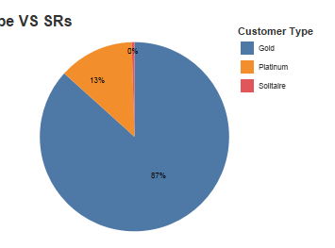
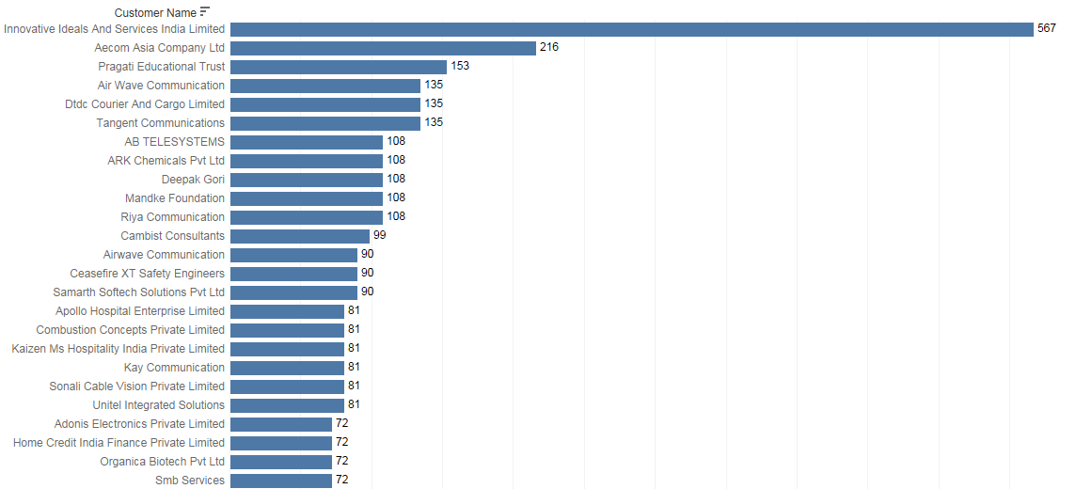
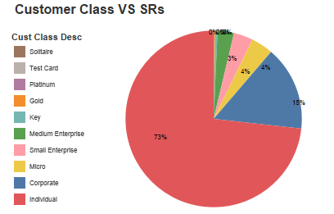
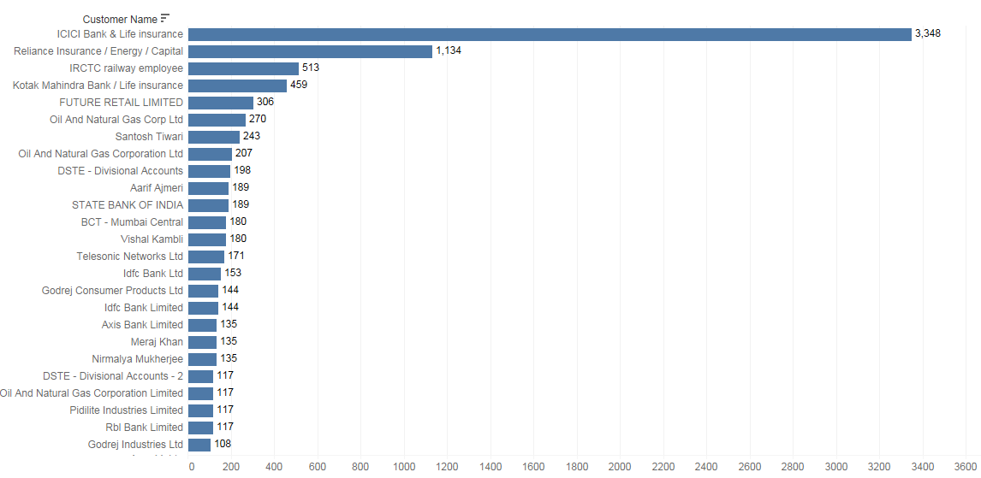
3. Business Problem : To acknowledge & convey which customer’s or class have reported frequent issue and which customer’s has to be targeted with special potential and fast tracking system with as low as possible SLA.
1. Customer Type vs No. of SR’s
2. Customer Class vs No. of SR’s
27%
1%
Customer Class [Micro] vs No. of SR’s
Highs : - <1% SR’s are raised by Solitaire customer’s.
Lows : - 73% SR’s are raised by individual's
- 27% SR’s are raised by Corporate’s, Small & Medium Enterprise or sectors, need special attention to avoid churn out to competitor. - ICICI Bank & Reliance Energy has reported most issues from corporate customer class & Innovative Ideas and Aecom Asia Pvt Ltd from Micro customer class
Customer Class [Corporate] vs No. of SR’s

Slide 27
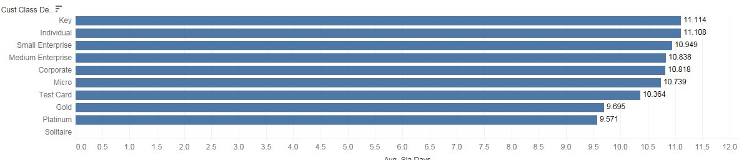
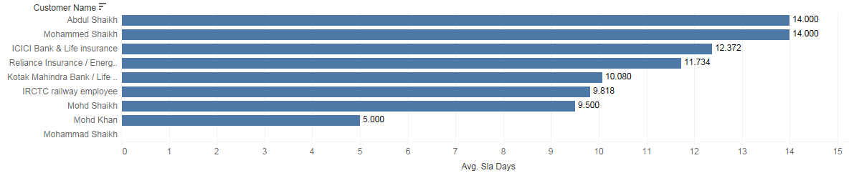
3. Business Problem : To acknowledge & convey which customer’s or class have reported frequent issue and which customer’s has to be targeted with special potential and fast tracking system with as low as possible SLA [Continue………]
Customer Class vs SLA Days
Ideal value
Customer Class [Corporate] vs SLA Days
Above Average Values
Solution / Suggestion :
Avg. SLA has to minimize [Currently Avg. SLA >=10 Days].
Focus required for Key, Small / Medium Enterprise and Corporate Account [“high SLA days”]
Special benchmarks to be made to reduce SLA days for ICICI bank and Reliance Energy [“SLA above the Avg of Corporate Account”], as they directly links companies performance and reputation.
Special solutions to be planned for corporate account & Small / Medium Enterprise to avoid churn to competitor due to high SLA and repetitive complaints.

Slide 28
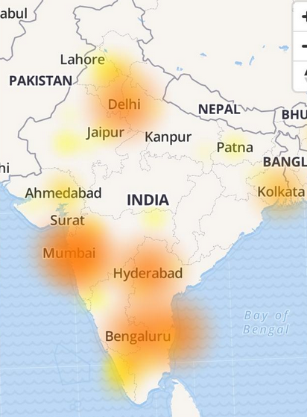
4. Business Problem : To check for the existence of Geographical locations with maximum SRs registered and distinguish by different SR status which needs attention.
No. of SR’s raised vs Geo location
Location Name
Location ID
Highs :
- <=5% Complaints are from Rest of India. - For Mumbai :: Location ID 1 to 4 :: Lowest SR’s :: High Customer Satisfaction Index - Kolkata with least complaints raised and best amongst the metro city.
Lows :
37% of complaints reported from Mumbai, followed by Bangalore [21%] & Delhi [19%]
For Mumbai :: Location ID 12, 13 & 15 :: Highest SR’s :: Low Customer Satisfaction Index

Slide 29
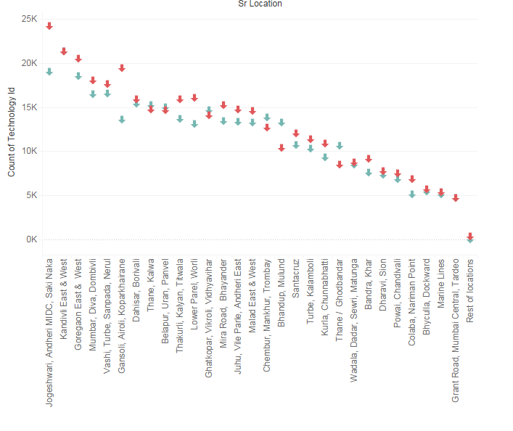

4. Business Problem : To check for the existence of Geographical locations with maximum SRs registered and distinguish by different SR status which needs attention [Continue………….]
No. of SR’s raised vs SR status vs Geo location [Mumbai]
Solution / Suggestion :
Prime Focus for marketing & network team for improvement : Mumbai.
In Mumbai : Jogeshwari & Kandivali location’s has the highest SR’s raised and SR Status : Resolved too – Need to get RCA for repeated SR’s occurrence’s.
In Mumbai location like : Chembur / Bhandup / Mulund / Thane ghodbander has high On-Hold to SR’s raised ratio – needs fast track closer with appropriate solutions

Slide 30
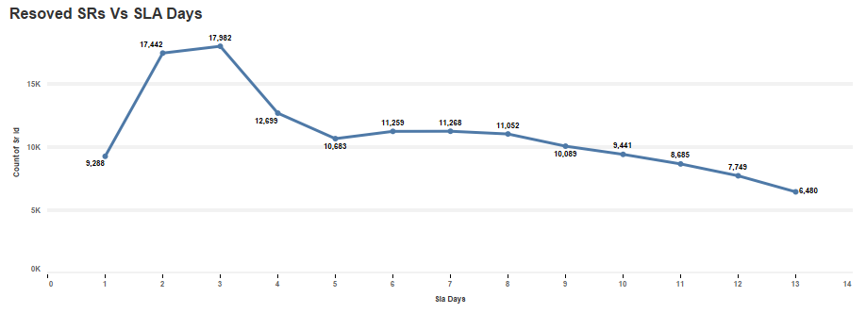
5. Business Problem : To check performance based on SLA days by comparing start date (Service request raised date) and resolution date along with On-Hold dates, which need attention and faster closer
Resolved SR’s vs SLA days
No. of SR’s :: Resolved
Highs : - 48% SR’s under Resolved category have <=5 days SLA days. - 2 to 4 Days is the average SLA days.
- Social Media has the lowest SLA days
Lows : - Minimize SLA days, should target >=8 days SLA days [39%]. - Month on Month - Increasing Trend - No. of SR’s under SR Status :: On-Hold. - Month on Month – On Hold cases :: increased for Telco Toll free, 3rd party retail store & Social media
SLA Days
No's of SR's [On-Hold :: SR Category]
No. of SR’s :: On-Hold
Month No

Slide 31
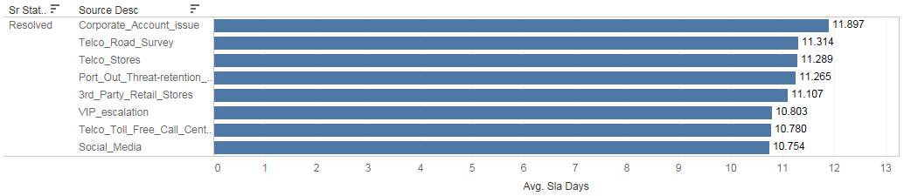
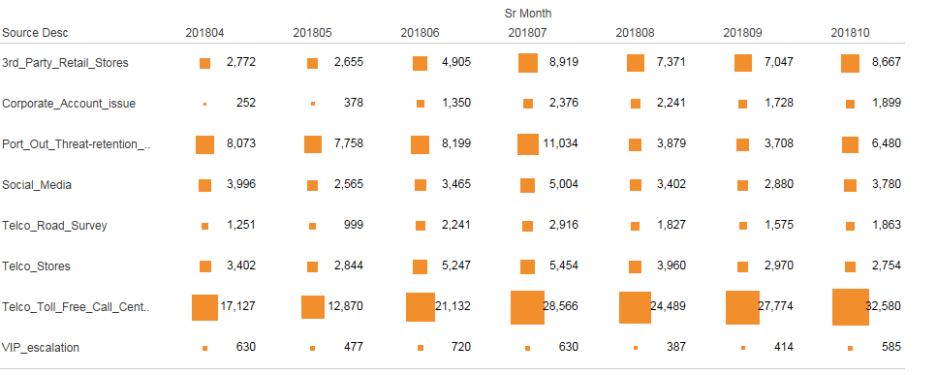
5. Business Problem : To check performance based on SLA days by comparing start date (Service request raised date) and resolution date along with On-Hold dates, which need attention and faster closer [Continue……..]
Source Type vs SLA Days [Resolved]
Ideal value
Source Type vs SLA Days [On-Hold]
Solutions / Suggestion :
- Avg. SLA has to minimize to less than <=8 days [Currently Avg. SLA >=10 Days].
- Focus required for Corporate Account [“highest SLA days”]
- Special benchmarks to be made to reduce SLA days & reduce On-Hold cases for Telco Toll free, Port Out Treat, 3rd party retail store & Social media cases as they directly links companies performance and reputation.

Slide 32
EXECUTIVE SUMMARY – Business problem & Suggestion
Sr. No | Business Problem | Tables Used | Highs | Lows | Suggestions & Solutions
1 | To acknowledge which service’s across technology is doing well & the most frequent issue type faced by the customer which needs attention. | sr_details | 2G Voice has very less contribution [i.e majority of customers = smart phone user] Roaming issue is very rarely reported, hence there is no intra-inter roaming issues. | 3G – Voice [33%] , 4G – Voice [17%] & 4G – Data [32%] is Major Chuck for Voice & Data related issues respectively | Focus required on resolving 3G Voice issues & 4G Data Issues. Insist to push customer’s to use VoLTE service which has higher performance metric. Areas were Coverage & Capacity Augmentation is required which need to be done via network team Faster closer and Special focus on On-Hold cases for 4G data issues [Major chuck]
 |  | technology
 |  | issue_type
2 | To acknowledge which is the most used source for reporting issues & the most frequent used sub-source type by the customer which needs attention and lower SLA. | sr_details | ~1% SR’s are obtain via Source Mode : VIP escalation Social Media has the lowest SLA days. | 19% SR’s reported :: Source :: Port Out Threat desk. AND 8% from Social Media, Major chunk from Sub source : Twitter [70%] Corporate Account has the highest SLA days | More Focus on resolving Telco Call center & Port out cases. Guidance and training to customer care faculty to understand customer’s VOC and try to resolve issues. Avg. SLA has to minimize [Currently Avg. SLA >=10 Days]. Focus required for Corporate Account [“highest SLA days”] Special benchmarks to be made to reduce SLA days for Corporate Accounts , VIP escalations, Port out desk and Social media cases as they directly links companies performance/reputation and helps to avoid churn out to competitor & loss of revenue.
 |  | sr_source
 |  | sr_subsource
3 | To acknowledge & convey which customer’s or class have reported frequent issue and which customer’s has to be targeted with special potential and fast tracking system with as low as possible SLA. | sr_details | <1% SR’s are raised by Solitaire customer’s. | 73% SR’s are raised by individual's 27% SR’s are raised by Corporate’s, Small/Medium Enterprise. ICICI Bank & Reliance Energy [corporate class] and Innovative Ideas [Micro class] most issues reported | Avg. SLA has to minimize [Currently Avg. SLA >=10 Days]. Focus required for Key, Small / Medium Enterprise and Corporate Account [“higher SLA days”]. Special benchmarks & Solution to be planned : - Reduce SLA days for ICICI bank and Reliance Energy [“SLA above the Avg of Corporate Account”] - Resolve frequently reported issues for Corporate account & Small Enterprise as they directly links companies performance/reputation and helps to avoid churn out to competitor & loss of revenue.
 |  | customer
 |  | customer type
 |  | customer class

Slide 33
EXECUTIVE SUMMARY – Business problem & Suggestion
Sr. No | Business Problem | Tables Used | Highs | Lows | Suggestions & Solutions
4 | To check for the existence of Geographical locations with maximum SRs registered and distinguish by different SR status which needs attention. | sr_details | <=5% Complaints are from Rest of India. Within Mumbai :: Location ID 1 to 4 :: Lowest SR’s Kolkata with least complaints raised [best amongst the metro city]. | 37% of total complaints reported from Mumbai [Highest], followed by Bangalore [21%] & Delhi [19%] Within Mumbai :: Location ID 12, 13 & 15 :: Highest SR’s :: Low Customer Satisfaction Index | Prime Focus for marketing & network team for improvement : Mumbai. In Mumbai : Jogeshwari & Kandivali location’s has the highest SR’s raised and SR_status :: Resolved too – Need to get RCA for repeated SR’s occurrence’s. In Mumbai location like : Chembur / Bhandup / Mulund / Thane ghodbander has high On-Hold to SR’s raised ratio - Fast track closer with appropriate solutions.
 |  | sr_location
 |  | sr_status
5 | To check performance based on SLA days by comparing start date (Service request raised date) and resolution date along with On-Hold dates which need attention and faster closer | sr_details | 48% SR’s under Resolved category have <=5 days SLA days. 2 to 4 Days is the average SLA days. Social Media has the lowest SLA days. | Minimize SLA days, should target >=8 days SLA days [39%]. Month on Month – Increasing Trend [No. of SR’s under SR Status :: On-Hold]. Month on Month – On Hold cases :: increased for Telco Toll free, 3rd party retail store & Social media | Avg. SLA has to minimize to less than <=8 days [Currently Avg. SLA >=10 Days]. Focus required for Corporate Account [“highest SLA days ~11.8 days”] Special benchmarks to be made to reduce SLA days & reduce On-Hold cases for Telco Toll free, Port Out Treat, 3rd party retail store & Social media cases as they directly links companies performance and reputation.
 |  | sr_status
 |  | customer type

Slide 34
RECOMMENDATIONS
Encourage customers to use more efficient mechanisms such as Telco App, SMS and Telco Stores to report service issues (Toll free call is inefficient and resource, cost intensive)
Involve Engineering to look at stability issues with 3G Voice and 4G Data as they are the technologies with most issues.
Involve Engineering to get RCA along with Strong plan to improve Locations where higher % of Voice and Data issues are observed
Streamline resolution process to reduce time to resolve requests

Slide 35
LESSONS LEARNT (on project)
Cleanup unneeded data - there is too much data that is not relevant to the analysis/goal at hand, cleaning it helps focus efforts on desired goals
Always keep the desired state/goals in mind to keep the analysis focused on the dimensions that matters.

Slide 36
Thank you !!

